Slide 1
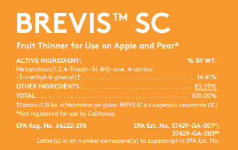
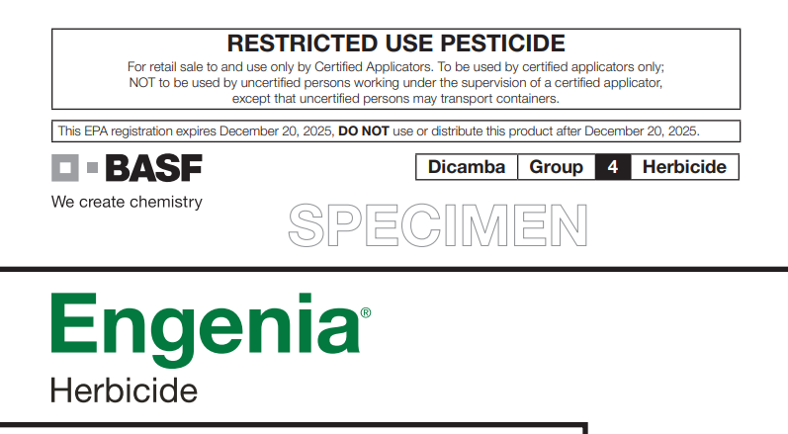
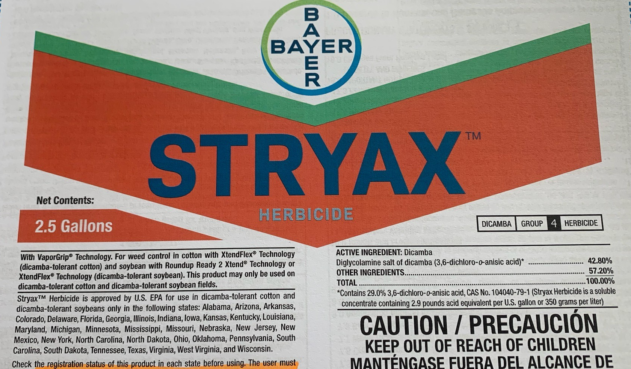
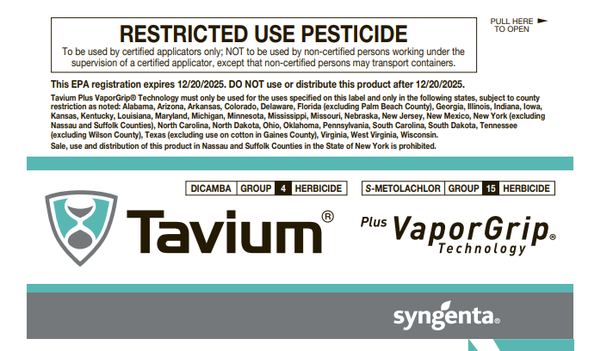
WSSA Structured Pesticide Labels Initiative
BENEFITS
Same table of contents order for all labels
More tables and less text
Specific tables for application methods and sites
Potentially quicker product commercialization
Improved label understanding and stewardship
Similar format across all labels
4 successful labels so far
HELP NEEDED
Reach out to pesticide manufacturers, retailers, detailers and let them hear your thoughts on these structured pesticide labels

