Slide 1
Aquatic Plant Control Funding: 2016 - 2021
 | FY16 | FY 17 | FY 18 | FY19 | FY20 | FY21
 | ---------------------------- $ Millions ----------------------------
CONSTRUCTION | 1,631 | 1,876 | 2,050 | 2,183 | 2,681 | 2,693
APC - TOTAL | 4 | 9 | 11 | 12 | 24 | 25
APC Research | 4 | 4 | 5 | 5 | 5 | 6
Flowering rush & hydrilla control | n/a | n/a | 1 | 1 | 1 | 1
CT River & Lake Champlain hydrilla | n/a | n/a | n/a | n/a | n/a | n/a
Watercraft inspec- tion stations | n/a | 5 | 5 | 6 | 18 | 18
APC = Aquatic Plant Control program

Slide 2
Aquatic Plant Control Funding: 2022 – 2025
 | FY22 | FY 23 | FY 24 | FY25 House | FY25 Senate | FY25 ACOE
 | ---------------------------- $ Millions ----------------------------
CONSTRUCTION | 2,493 | 1,809 | 1,855 | 3,010 | 2,979 | 2,052
APC - TOTAL | 30 | 38 | 20.5 | 31 | 29.3 | 0
APC Research | 7 | 7 | 5 | 5.5 | 10.3 | 0
Flowering rush & hydrilla control | 1 | 2 | 1 | 2 | 0 | 0
CT River & Lake Champlain hydrilla | n/a | 6 | 5 | 0 | 7.5 | 0
Watercraft inspec- tion stations | 18 | 19 | 9 | 13 | 0 | 0
Asian Carp Pilot | 0.15 | 0.5 | 0.15 | 10.5 | 10.5 | 0

Slide 3
FY 2026 House Appropriations
CORPS OF ENGINEERS—CIVIL
The following appropriations shall be expended under the direction of the Secretary of the Army and the supervision of the Chief of Engineers for authorized civil functions of the Department of the Army pertaining to river and harbor, flood and storm damage reduction, shore protection, aquatic ecosystem restoration, and related efforts.
CONSTRUCTION Account
  $2,555,000,000 to remain available until expended
Notes:
Glyphosate will be next.

Slide 4
CONGRESSIONALLY DIRECTED SPENDING
The Appropriations Committee funds only projects and studies that are authorized by law. All projects requested and funded are listed in a table accompanying the report and have gone through the same rigorous process and approvals as those proposed by the President.
The work funded through congressionally directed spending has been authorized by Congress and was requested by project sponsors and local communities, displaying the importance of the work to the American people.
Consequently, the Corps is directed to continue prioritizing these ongoing studies and projects, both in the work plan and future budget requests.
Notes:
Glyphosate will be next.

Slide 5
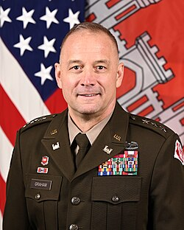
Butch Graham: Commanding General of the U.S. Army Corp of Engineers
On July 31, 2024, the Senate confirmed Army Maj. Gen. William H. “Butch” Graham Jr. as the next chief of engineers and commanding general of the U.S. Army Corps of Engineers (US ACOE).
Graham succeeded Lt. Gen. Scott A. Spellmon, whose four-year term as chief ended on September 13, 2024.
Industry leaders say he is a supporter of the inland waterways and understands the importance of partnering with the dredging, marine construction and all private sector industries. Prior to this, he served as the deputy chief of engineers and deputy commanding general for Civil Works and Emergency Operations.
Notes:
Glyphosate will be next.

Slide 6
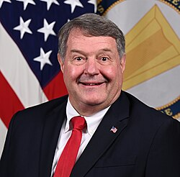
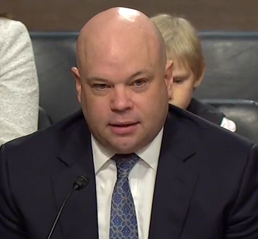
Assistant Secretary of the Army for Civil Works
(ASA-CW)
Mr. Lee Forsgren was appointed Principal Deputy Assistant Secretary of the Army (Civil Works) on 31 March 2025 and is currently the Acting ASA-CW.
Been in DC for 40 yrs. Lawyer for a consulting firm focused on energy, environment, conservation, technology, and transportation issues.
J.D. from George Mason in May 1990 and a B.S. from US Merchant Marine Academy in June 1983.
On May 13, Adam Telle was nominated to be ASA-CW by Sen. Bill Haggerty (R-TN), where served as his Chief of Staff for the past 4 yrs.
Native of Northport, AL. MS St. grad. Spent last 20 yrs in DC. Worked for Sen. Thad Cochran (R-MS) for 10 yrs.
Notes:
Glyphosate will be next.

Slide 7
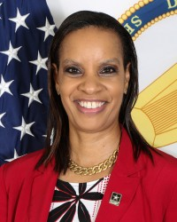
Ms. Stacey Brown: Deputy Assistant Secretary of the Army for Management and Budget
Ms. Stacey E. Brown serves as the principal advisor on management and budget issues to the ASA-CW.
Responsible for all matters related to the development and implementation of the Civil Works budget.
Started with the Corps in 1989 and has spent her entire career there at either district offices or HQ.
Has a Bachelor of Science in Civil Engineering, a Bachelor of Arts in English, and a Minor in Engineering Management, all from Tufts University in Medford, MA in 1989.
Notes:
Glyphosate will be next.

Slide 8
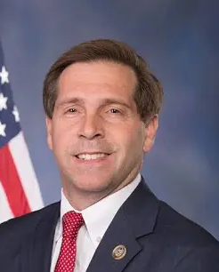
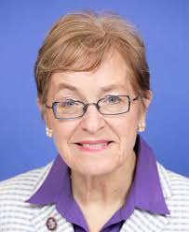
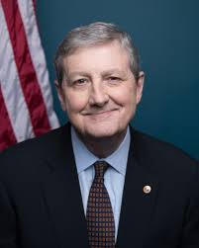
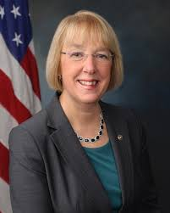
House & Senate Energy & Water
Appropriations Leaders
Rep. Chuck Fleischmann
R-TN
Chair
Rep. Marcy Kaptur
D-OH
Ranking
Member
Sen. John Neely Kennedy
R-LA
Chair
Sen. Patty
Murray
D-WA
Ranking
Member
kathleen_
williams@
appro.senate.gov
richie.o'connell@
mail.house.gov
scott.mckee@
mail.house.gov
Laura_powell@
appro.senate.gov

Slide 9
Action Plan
Stakeholder letter to ASA-CW Leadership
  Cc: Congressional appropriators
Visits (virtual, but in-person preferred) to Pentagon to meet with ASA-CW Leadership
Visits with key appropriators & staff.
Direct the Corps to continue prioritizing these ongoing studies and projects, both in the work plan and future budget requests.
Notes:
Glyphosate will be next.

