Slide 1


What is Herbicide Resistance?
Lesson 3
The copyright in these Weed Science Society of America (WSSA) training lessons is owned by the WSSA. WSSA grants you a limited license to use these materials solely for training and educational purposes. Slides may be used individually, and their order of use may be changed; however, the content of each slide and the associated narrative may not be altered. If you have questions, please contact Joyce Lancaster at (jlancaster@allenpress.com) and phone (785-865-9250).
Notes:
Welcome to Lesson 3 of the herbicide-resistant weeds training lessons, provided by the Weed Science Society of America. Before you begin Lesson 3, you should have some understanding of the growing problem of herbicide-resistant weeds, including the need for better management strategies, and an understanding of how herbicides work. Lesson 3 is titled “What is Herbicide Resistance?”
<mouse click>

Slide 2
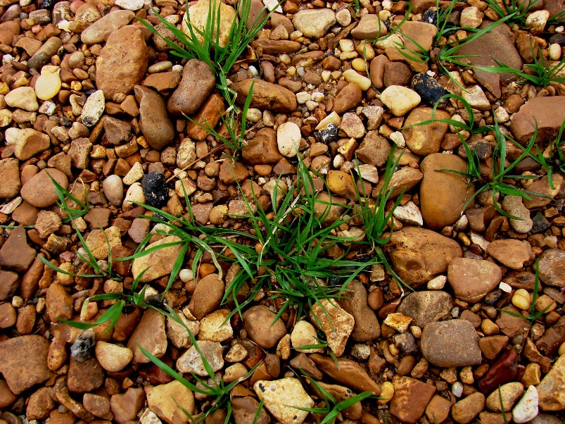
Objectives
By the end of this lesson, you will:
Understand what herbicide resistance is and how it evolves in the field.
Recognize the factors that influence selection for herbicide resistance.
Above: Immature stage of annual ryegrass, a weed that is known to be resistant to several herbicides.
Photo: Jason Bond, Mississippi State University
Define the different types of herbicide resistance.
Notes:
Lesson 3 is designed to introduce the fundamentals of herbicide resistance in weeds, including: <mouse click> what resistance is, and how it evolves in the field, <mouse click> the factors that influence selection for herbicide resistance, and <mouse click> the different types of herbicide resistance.
<mouse click>

Slide 3

Herbicide Resistance Defined
Herbicide resistance can be defined as the acquired ability of a weed population to survive a herbicide application that previously was known to control the population.
The number of herbicide-resistant individuals in the population changes over time.
In herbicide resistance there is a change in the response of the weed population over time; it is no longer controlled by the herbicide.
In herbicide tolerance, there is no change over time, the population has always been tolerant to the herbicide.
Year 1
Year 2
Later years
Herbicide tolerance is the inherent ability of a species to survive and reproduce after herbicide treatment. There has been no selection acting on the tolerant weed species, and there has been no change in the weed species lack of response to the herbicide over time.
The number of herbicide-tolerant individuals is not affected directly by the herbicide.
For More
Information
Year 1
Year 2
Later years
Notes:
Herbicide resistance can be defined as the acquired ability of a weed population to survive a herbicide application that previously was known to control the population. In this case ‘acquired’ refers to the fact that resistance evolves in relationship to how a herbicide is used over time in a weed management system.
As you can see in the illustration, in year 1, there is only one herbicide-resistant plant shown in black and numerous susceptible plants shown in green. When using the same herbicide year after year, the ratio of herbicide-resistant to herbicide-susceptible plants changes such that herbicide-resistant plants make up more and more of the population. There is a change in the population over time.
<mouse click> In contrast, herbicide tolerance is the inherent ability of a species to survive and reproduce after herbicide treatment. There has been no selection acting on the tolerant weed species, and there has been no change in the weed species lack of response to the herbicide over time. The size and density of the tolerant weed species population may change, but this is due to an absence of control and/or the elimination of competition from susceptible weed species as specified on the label, rather than a direct effect of the herbicide.
<mouse click> As you can see in the illustration at the bottom, there has been no change in this population over time. The plants that start out as tolerant survive, reproduce, and pass on an ability to tolerate the herbicide to their offspring.
<mouse click> In summary, herbicide resistance is a change in the weed population over time. In herbicide tolerance, there is no change over time.
The Weed Science Society of America has developed official definitions for herbicide resistance and herbicide tolerance. These were developed for scientific uses. These definitions can be reviewed by clicking the For-More-Information button.
<mouse click>

Slide 4
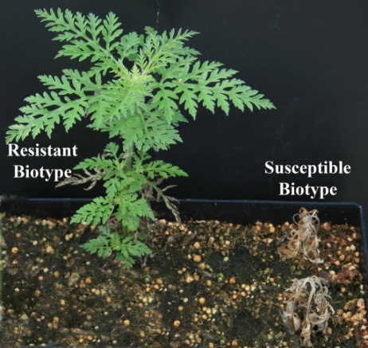
Herbicide Resistance: Basic Principles
In general, weed populations are genetically diverse, and individual plants within a species can respond differently to the same herbicide rate. This does not mean, in all cases, that the least sensitive individuals are herbicide-resistant, but it is a possibility. Herbicide rates are initially established to be effective on the vast majority of the individuals in a population under normal growing conditions. This is why using labeled rates is important.
[Click to close.]
Herbicide resistance is the result of naturally occurring processes.
Herbicide-resistant individuals or biotypes* are present naturally within the weed population at very low frequencies. These individuals have a herbicide resistance mechanism that allows them to survive the application of a herbicide.
Weed control failures do not automatically mean that the weeds are herbicide-resistant.
* Biotypes are plants within a species that have biological characteristics that are not common to the population as a whole.
  Resistance is heritable. It can be passed from one generation to the next.
For More
Information
Notes:
Herbicide resistance is the result of naturally occurring processes. Before a herbicide is even sprayed, <mouse click> individual plants that are herbicide-resistant (or biotypes) are present within the weed population at very low frequencies. These individuals have a herbicide resistance mechanism that allows them to survive the application of a herbicide. They reproduce and increase their numbers, or frequency, within a population. <mouse click> Biotypes are individual plants within a species that have specific biological characteristics that are not common to the weed population as a whole.
<mouse click> Weed control failures do not automatically mean that the weeds are herbicide-resistant.
<mouse click> Remember, herbicide resistance is inherited. It is passed from one generation to the next.
<mouse click>

Slide 5
Selection by Herbicides Changes the Population Over Time
Year 1
Example
Year 2
Year 2 begins with more resistant weeds
1 in a million resistant to a herbicide
Resistant weeds produce seed
Susceptible weeds die
Resistant weeds mature
Spray with herbicide
Notes:
<Narrative below belongs to both slides 5 and 6.>
Let’s pause for a moment to watch an animation that puts all of these concepts together.
<The animation runs on autoplay.>
The example begins in year 1, in a field where 1 plant out of many (in some cases millions) is resistant to a herbicide.
The herbicide related to the herbicide resistance mechanism is sprayed.
Susceptible weeds die.
Herbicide-resistant weeds mature.
Resistant weeds produce seed, and year two begins with a greater proportion of herbicide-resistant individuals as seeds in the soil seed bank.
<mouse click to Slide 6>
In year 2, the process repeats, with growing numbers of individual herbicide-resistant plants in the population, until some years later, when the number of herbicide-resistant individuals is greater than the number of susceptible individuals, and the weed population overall is characterized as herbicide-resistant.
<mouse click>

Slide 6
Selection by Herbicides Changes the Population Over Time
Year 2
Example
Year 3
And in later years
even more herbicide-resistant weeds are present
…Until Year 3 has significant weed resistance…
The process repeats…

Slide 7
Factors Affecting Speed of Selection
Another factor affecting the speed of selection is the mechanism of herbicide resistance. There are two general types of mechanisms: (1) exclusionary resistance (for example, differential uptake and translocation, compartmentalization and metabolic detoxification) and (2) target site resistance (alteration of the targeted enzyme and overproduction of a specific enzyme). Exclusionary resistance generally takes longer to evolve in the field.
[Click to close.]
The length of time for selection of resistance varies by :
Cultural practices
Frequency of herbicide use
Herbicide mechanism of action
Biology of weed species
Frequency of resistant biotypes among weed species
For More
Information
Year 0
Year 2
Year 4
Year 6
Year 8
Year ?
Later
Notes:
Several factors can affect the speed at which the evolution of herbicide-resistant weeds occurs. The top three items on this list are things that can be actively controlled in the field to delay the evolution of herbicide resistance: <mouse click> diverse cultural practices, less frequent use of a single herbicide, and combining or rotating among herbicide mechanisms of action can slow the process. In contrast, the <mouse click> bottom two items are generally random events outside of a grower’s control. The biology of a weed species and the initial frequency of herbicide-resistant individuals within a population cannot be changed. Some land management practices (for example, crop rotation) can affect which weeds are present and indirectly affect weed biology.
<mouse click> The exact period of time it takes for herbicide-resistant individuals to become dominant in a weed population is unknown. It may take 4, 6, 8 years, or more. Furthermore, selection may be ongoing for several years before a herbicide-resistant population is noticed.
For more information on factors that can affect the speed of selection, please click the For-More-Information button.
<mouse click>

Slide 8

Level of Herbicide Resistance
The level of herbicide resistance in weeds varies by weed biology and resistance mechanism.
In some cases, resistance occurs when the species survives application of a labeled rate, while in other cases, the species can survive up to 1000 times the labeled rate. (1X equals the labeled rate.)
1X to 1000X
This is important in terms of being able to identify herbicide resistance in the field.
Notes:
The level of herbicide resistance found across all weeds and herbicide resistance mechanisms is not uniform. Rather, the level of herbicide resistance in weeds varies by weed biology and the herbicide resistance mechanism.
<mouse click> In some cases, resistance occurs when the weed species survives application of a labeled herbicide rate, while in other cases, the species can survive up to 1000 times the labeled rate, a test that is conducted in a laboratory setting.
<mouse click> An awareness of varying levels of herbicide resistance is important in terms of being able to identify herbicide resistance in the field. A weed with high-level herbicide resistance often does not show herbicide injury symptoms, while a weed with low-level herbicide resistance can be injured, yet survives and reproduces. Let’s look at some characteristics of these two herbicide resistance levels in more detail.
<mouse click>

Slide 9
Herbicide Resistance Characteristics
Low-Level Resistance
High-Level Resistance
  A continuum of plant responses from slightly injured to nearly dead
  The majority of plants display an intermediate response
  Susceptible plants will be present in the population, especially when herbicide resistance is determined early
  Plants are slightly injured to uninjured
  Few plants have an intermediate responses
  Susceptible plants can be present in the population
Examples
Examples
Diuron, Princep, Hyvar, etc.
Roundup, etc.
GROUP | 5 | HERBICIDE
GROUP | 9 | HERBICIDE
Outrider, Escort, Plateau, etc.
Piper, etc.
GROUP | 14 + 15 | HERBICIDE
GROUP | 2 | HERBICIDE
Garlon, 2,4 D, etc.
GROUP | 4 | HERBICIDE
Envoy, etc.
Reward, etc.
GROUP | 22 | HERBICIDE
GROUP | 1 | HERBICIDE
Notes:
The common characteristics of low-level and high-level herbicide resistance are different, especially when observed early in the evolution of the weed population.
In low-level herbicide resistance, <mouse click> a continuum of plant responses from slightly injured to nearly dead is observed with <mouse click> the majority of plants displaying an intermediate herbicide response. <mouse click> Susceptible plants will be present in the population, especially when herbicide resistance is determined early. Some examples of herbicides known to select for low-level herbicide resistance are <mouse click> Roundup (group 9, EPSP synthase-inhibitors ), Piper (group 14, PPO-inhibitor + 15, mitosis inhibitor), Garlon and 2,4-D (group 4, synthetic auxins), and Reward (group 22, photosystem I-inhibitors).
High-level herbicide resistance is generally easier to diagnose in the field. In weeds with high-level herbicide resistance, <mouse click> plants are either dead (susceptible) or uninjured (resistant) with <mouse click> few plants having intermediate responses. <mouse click> Susceptible plants can be present in the population. Some examples of herbicides known to select for high-level resistance are <mouse click> Diuron, Princep, and Hyvar (group 5, 6, and 7, PS II inhibitors), Outrider, Escort, and Plateau (group 2, ALS-inhibitors), and Envoy (group 1, ACCase-inhibitors).
<mouse click>

Slide 10
Herbicide Resistance Types
Single Herbicide Resistance
Resistant to only one herbicide
Herbicide A
MOA #1
Cross Herbicide Resistance
Resistant to two or more herbicide families with same mechanism of action
Single resistance mechanism
Herbicide A
MOA #1
Herbicide B
MOA #1
Multiple Herbicide Resistance
Resistant to two or more herbicides with different mechanisms of action
May be the result of two or more different resistance mechanisms
Herbicide A
MOA #1
Herbicide C
MOA #2
Notes:
Some weeds are only resistant to one herbicide, known as single herbicide resistance, while other weeds may be resistant to more than one herbicide, either through cross resistance or multiple resistance.
<mouse click> Cross resistance occurs when a weed is resistant to two or more herbicides due to a single herbicide resistance mechanism.
<mouse click> Multiple resistance occurs when a weed is resistant to several herbicides with different mechanisms of action. This type of resistance may be the result of two or more different resistant mechanisms within the same plant.
We will now look at cross and multiple resistance in more detail using two examples from the field.
<mouse click>

Slide 11
Herbicide Resistance Types: Cross Resistance
An example with common ragweed
Year 1
Year 2
Year 3
Apply Oust®
Apply Oust
Apply Plateau®
Resistant to Oust
Resistant to Oust
Resistant to Oust and Plateau herbicides (group 2, ALS-inhibitors)
Oust, a sulfonylurea, and Outrider, an imidazolinone, both belong to the ALS-inhibitors, or group 2 herbicides. Both herbicide products have the same mechanism of action.
CAUTION: Weeds that are herbicide-resistant to one member of a herbicide mechanism of action group may or may not be cross-resistant to all herbicides within that group. Consult your local extension specialist for more information.
Notes:
Common ragweed is a summer annual weed that is found throughout the USA. In year 1, Oust, or sulfometuron-methyl, a group 2 herbicide, is applied for control of common ragweed on a roadside. On the surface, it appears that the product worked well, except that an individual herbicide-resistant weed, shown in black, survived to produce seed. <mouse click> In year 2, several more common ragweed plants are herbicide-resistant, and also survive the application of Oust. <mouse click> In year 3, the applicator decides to apply Plateau herbicide, or imazapic, thinking it has a different active ingredient, it must work differently. <mouse click> However, Oust and Plateau are both group 2, or ALS-inhibiting herbicides. The common ragweed in this example is cross-resistant to both Oust and Plateau. <mouse click> Weeds that are herbicide-resistant to one member of a herbicide mechanism of action group may or may not be cross-resistant to all herbicides within that group. Consult your local extension specialist for more information. In many cases, weeds must be tested to determine if cross resistance did occur.
<mouse click>

Slide 12
Herbicide Resistance Types: Multiple Resistance
Example
Apply Overdrive
Switch to and apply glyphosate
Years 1-5
Years 5-8
Years 8-13
Years 14 +
Select for weeds resistant to group 9 herbicides (shown in pink) from a population that is resistant to group 5
Select for weeds resistant to group 4 herbicides (shown in black)
The population with resistance to group 4 herbicides increases
The population with multiple resistance to group 4 and 9 increases
Multiple resistance can occur following repeated applications of a single herbicide and selection for herbicide-resistant biotypes followed by repeated applications of another herbicide and selection for herbicide-resistant biotypes.
Notes:
In this example, a contract applicator applies Overdrive (dicamba+diflufenzopyr) several years in a row. Ultimately, the herbicide selects for weeds that are resistant to dicamba, or group 4 herbicides. With continued use, the <mouse click> population increases, the county road supervisor is irate and cancels the applicator’s contract. The contract is let for bids and another applicator wins the bid. The new contractor is told Overdrive was used the past few years without success.<mouse click> The applicator switches to glyphosate (group 9) and uses it for several continuous years. The herbicide now selects for weeds that are resistant to glyphosate (shown in pink) from within a population that was already resistant to group 4 herbicides. <mouse click> The weed population that is present on this right of way in later years is resistant to both group 4 and group 9 herbicides.
<mouse click> Multiple resistance can occur following repeated applications of a single herbicide and selection for herbicide-resistant biotypes followed by repeated applications of another herbicide and selection for herbicide-resistant biotypes.
<mouse click>

Slide 13
Conclusions
Repeated use of a herbicide selects for herbicide-resistant biotypes. Over time, the number of resistant individuals in the weed population increases until the majority of the population is herbicide-resistant.
Several factors affect the selection of herbicide-resistant weeds.
Once a weed is resistant to a single herbicide, it is possible for it to also be resistant to another herbicide, with either the same or a different mechanism of action.
Notes:
This concludes the introductory lesson on herbicide resistance. Several important concepts were presented in this lesson, which include: repeated use of a herbicide selects for herbicide-resistant weeds because the susceptible plants are killed and do not reproduce; <mouse click> Several factors affect the selection of herbicide-resistant weeds, and <mouse click> once a weed is resistant to a single herbicide, it is possible for it to be resistant to another herbicide, either with the same or a different mechanism of action.
Two additional training lessons follow. Topics to be covered include scouting and confirming herbicide resistance, and principles of managing herbicide resistance. You may continue with these lessons now, or save your work and return at a later time.

Slide 14
Credits:
This lesson was developed by a WSSA sub-committee and reviewed by the WSSA Board of Directors and other WSSA members before being released. The sub-committee was composed of the following individuals.
Wes Everman, PhD (North Carolina State University)
Les Glasgow, PhD (Syngenta Crop Protection)
Lynn Ingegneri, PhD (Consultant)
Jill Schroeder, PhD (New Mexico State University)
David Shaw, PhD (Mississippi State University)
John Soteres, PhD (Monsanto Company) (Sub-committee chairman)
Jeff Stachler, PhD (North Dakota State University and University of Minnesota)
François Tardif, PhD (University of Guelph)
The module was adapted for noncropland applicators by John D. Byrd, Jr., Ph. D. (Mississippi State University) and William W. Witt, Ph. D. (University of Kentucky, retired).
Financial support for this was provided by Global HRAC, North America HRAC, and WSSA.
Our thanks are extended to the National Corn Growers Association for allowing us to use training materials posted on their website as the starting point for these training lessons.

Slide 15
Herbicide Resistance WSSA Definitions
Click here
To return
"Herbicide resistance is the inherited ability of a plant to survive and reproduce following exposure to a dose of herbicide normally lethal to the wild type. In a plant, resistance may be naturally occurring or induced by such techniques as genetic engineering or selection of variants produced by tissue culture or mutagenesis."
Resistant biotype
Year 1
Year 2
Later years
"Herbicide tolerance is the inherent ability of a species to survive and reproduce after herbicide treatment. This implies that there was no selection or genetic manipulation to make the plant tolerant; it is naturally tolerant."
Tolerant species
Year 1
Year 2
Later years
Notes:
The WSSA has defined herbicide resistance as “the inherited ability of a plant to survive and reproduce following exposure to a dose of herbicide normally lethal to the wild type. In a plant, herbicide resistance may occur naturally or may be induced by genetic engineering or selection of variants produced by tissue culture or mutagenesis.”
As you can see in the illustration, in year 1, there is only one herbicide-resistant plant shown in black and numerous susceptible plants shown in green. When using the same herbicide year after year, the ratio of herbicide-resistant to herbicide-susceptible plants changes such that herbicide-resistant plants make up more and more of the population. There is a change in the population over time.
There are several key phrases in the definition of herbicide resistance: #1, resistance must be passed on to the offspring; #2, the plant must be able to reproduce; and #3, the plant must have been previously controlled by the herbicide. These characteristics are what help to define herbicide resistance.
In contrast, herbicide tolerance is “the inherent ability of a species to survive and reproduce after herbicide treatment. This implies that there was no selection or genetic manipulation to make the plant tolerant; it is naturally tolerant.”
While this definition may seem similar to herbicide resistance, a key difference is expressed in the words “inherent ability.” It means that there has been no change in the population. In other words, it was never controlled by the herbicide in the first place.
As you can see in the illustration at the bottom, there has been no change in this population over time. The plants that start out as tolerant survive, reproduce, and pass on an ability to tolerate the herbicide to their offspring.
In summary, herbicide resistance is a change in the weed population over time. In herbicide tolerance, there is no change over time.
Please click on the “click here to return” button at the top of the slide to continue with the lesson.

