Slide 1


How Herbicides Work
Lesson 2
The copyright in these Weed Science Society of America (WSSA) training lessons is owned by the WSSA. WSSA grants you a limited license to use these materials solely for training and educational purposes. Slides may be used individually, and their order of use may be changed; however, the content of each slide and the associated narrative may not be altered. If you have questions, please contact Joyce Lancaster at (jlancaster@allenpress.com) and phone (785-865-9250).
Notes:
Welcome to Lesson 2 of the herbicide-resistant weeds training lessons, provided by the Weed Science Society of America. Before you begin Lesson 2, you should have some understanding of the growing problem of herbicide-resistant weeds, including the need for better management strategies. Lesson 2 is titled “How Herbicides Work.”
<mouse click>

Slide 2
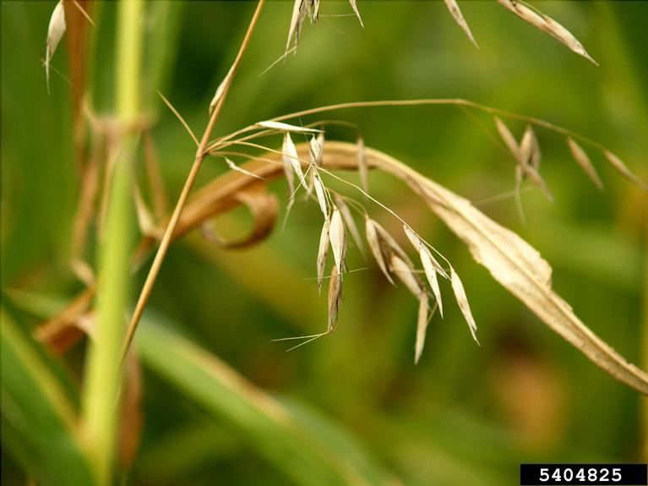
Objectives
By the end of this lesson, you will:
Know the terminology associated with herbicide use, including tolerance, chemistry, efficacy, timing, and placement of applications.
Understand how herbicides are categorized according to their mechanism of action.
Above: Inflorescence of wild oat, a weed that is known to be resistant to several herbicides.
Image number 5404825 at www.invasive.org.
Notes:
Lesson 2 introduces several important terms related to herbicides and herbicide use. By the end of this lesson, you will <mouse click> know the terminology associated with herbicide use, including tolerance, chemistry, efficacy, timing, and placement of applications, and <mouse click> understand how herbicides are categorized according to their mechanism of action.
<mouse click>

Slide 3
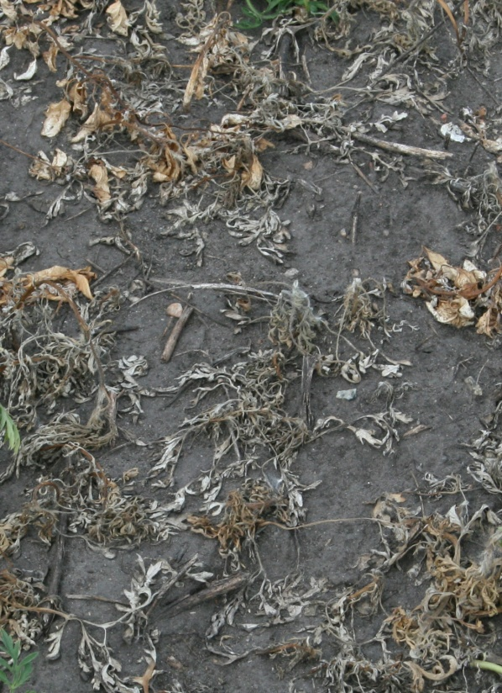
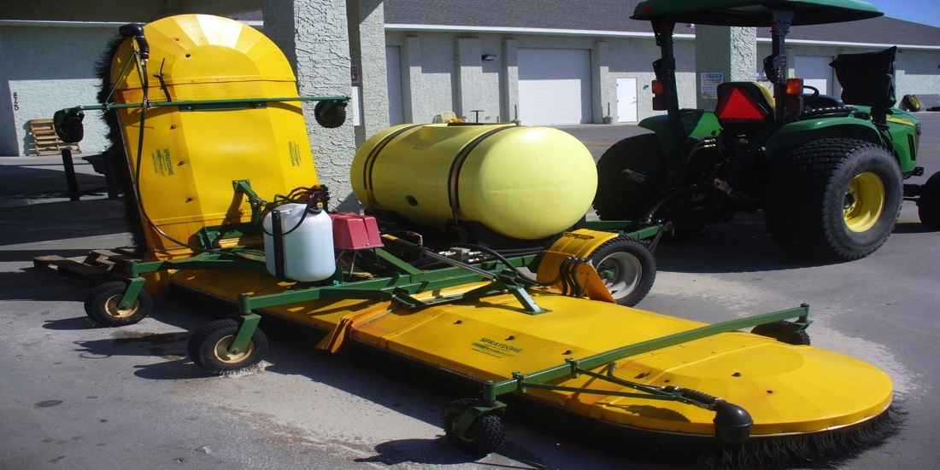
What is a Herbicide?
Herbicide: A chemical used to control or kill plants.
Notes:
A herbicide is a chemical used to control or kill plants, usually weeds. By definition, it can be effective against all or some plant species.
<mouse click>

Slide 4
Definitions Related to Herbicides
Active Ingredient (a.i.): The chemical in a commercial product that is primarily responsible for controlling weeds.
  Specifically identified on the product label
  Also known as a herbicide’s common name
Herbicide Chemistry: A method of classifying herbicide active ingredients into groups.
  Herbicide chemical families (or classes)
  According to their common chemical structure
Notes:
Several terms are important descriptors of herbicides.
The active ingredient, or a.i., is the specific component in the commercial herbicide product that is primarily responsible for controlling the weeds. In other words, it is the primary biologically-active component. An awareness of the active ingredient or ingredients in herbicide products is an important part of making decisions in the management of herbicide-resistant weeds. Furthermore, an awareness of the active ingredient or ingredients is the only way to determine what combinations of herbicides are best suited to managing herbicide resistance. The primary active ingredients are identified on all herbicide product labels. Primary active ingredient may be referred to as the herbicide common name on the label or in other product literature, such as brochures or extension publications. Commercial herbicide products that are pre-mixtures have more than one herbicide active ingredient.
<mouse click>
Herbicide chemistry refers to a method of classifying herbicides by categorizing them into families or classes according to the common chemical structure of their active ingredient. Herbicide families are most likely a familiar form of herbicide classification. For example, Classic, Resolve, and Beacon herbicides are members of the sulfonylurea family. Members of the same herbicide family will generally affect susceptible weeds in similar ways.
Categorization by herbicide chemical family is a useful technique for learning the general characteristics of herbicides and diagnosing herbicide injury symptoms. Herbicide resistance management strategies based solely on herbicide chemical family, however, may not provide the necessary diversity in management practices needed for herbicide-resistant weeds.
<mouse click>

Slide 5
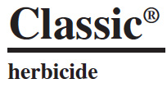
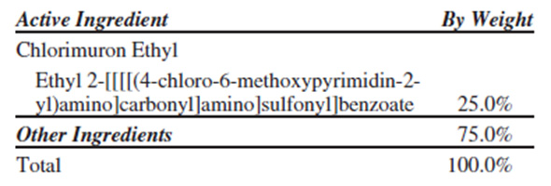
Herbicide Names on a Label
The Trade name or Product name, describes the formulated product and may contain more than one a.i.
Common name of a.i.
Chemical name of a.i.
Notes:
A herbicide will have one chemical and one common name, but it may have more than one trade name. <mouse click> The trade name is assigned by the manufacturer, and you will often see a symbol for the trademark or registered trademark next to the trade name. <mouse click> The chemical name describes the chemical structure of the compound. <mouse click> The common name is usually a simpler means of describing the chemical name. When reading and evaluating educational materials related to herbicide resistance in weeds, you will often come across information based on a herbicide common name, while you may or may not see the same trade name or names associated with the product.
<mouse click>

Slide 6
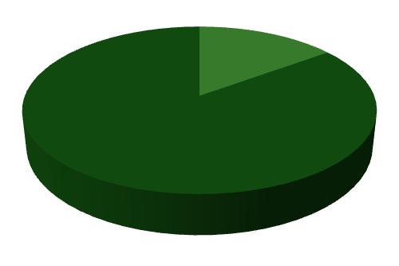
Herbicide Efficacy
Example:
For many weed species, a herbicide controlling 85% or more of the target weed population has good efficacy.
The weeds are susceptible to the herbicide.
Herbicide Efficacy: A measure of herbicide activity.
The ability of a herbicide to produce the desired effect.
Controlled
Notes:
Herbicide efficacy is a measure of the inherent ability of a herbicide to control a particular weed species. Over time, weed scientists, agronomists, and other agricultural professionals have used many systems of evaluating and recording herbicide efficacy. A popular form is percent control.
<mouse click>
For example, a herbicide with good weed control is effective, or controls, 85% or more of the target population. The controlled weeds are susceptible to the herbicide. Herbicide efficacy is also dependent on the weed and situation. When weeds are easily controlled, and most weeds fall into this category, 95% control or better is expected. On the other hand, with some hard-to-control weeds, only 70% control is achieved. The herbicide label will usually specify the weed species that the product is expected to control, as well as provide a general guide for the expected level of control when the product is applied according to labeled directions.
<mouse click>

Slide 7

Herbicide Tolerance
Herbicide resistance can be defined as the acquired ability of a weed population to survive a herbicide previously known to be susceptible to that herbicide. Resistance is more fully explained in Lesson 3.
[Click to close.]
Herbicide tolerance is the inherent ability of a species to survive and reproduce after herbicide treatment. This implies that there was no selection or genetic manipulation to make the plant tolerant; it is naturally tolerant.
Herbicide tolerance is not synonymous with herbicide resistance.
By definition, if a weed has never been controlled and there has been no change in the weed population’s lack of response to a herbicide over time, the population is tolerant.
Selective herbicides are effective because the turf is tolerant to the herbicide.
Some herbicides are effective only on some weeds.
For More
Information
Notes:
Herbicide tolerance is the inherent ability of a species to survive and reproduce after herbicide treatment. This implies that there was no selection or genetic manipulation to make the plant tolerant; it is naturally tolerant. By definition, tolerance in crops is the basis for the selective use of herbicides or whenever weed control is desired while simultaneously protecting crop plants. <mouse click>
Herbicide tolerance is not synonymous with herbicide resistance. <mouse click> By definition, if a weed has never been controlled by a herbicide and there has been no change in the weed population’s lack of response to a herbicide over time, the population is tolerant.
<mouse click>
7

Slide 8


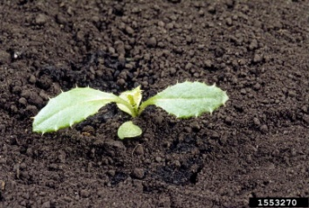
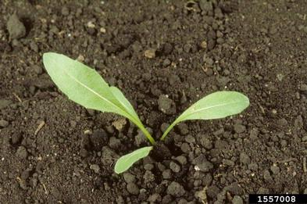
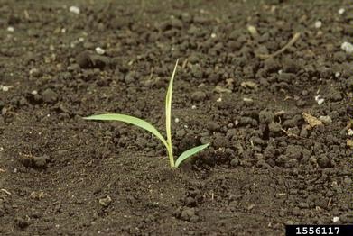
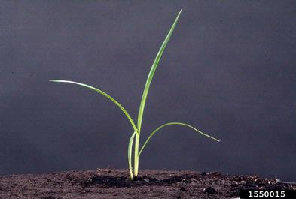

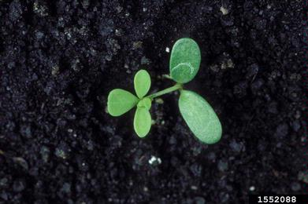
Herbicide Spectrum of Control
Narrow Spectrum: A herbicide that is more effective in controlling some plant species than others.
No activity
No activity
Activity
Broad Spectrum: A herbicide that controls many plant species.
Notes:
It is important to keep in mind that herbicides differ in the number and type of weeds they control. This is referred to as the weed spectrum. For example some herbicides control only a few plant species and thus have a limited or narrow spectrum of control.
<mouse click>
Herbicides that control many weed species are generally referred to as broad spectrum herbicides.
Sometimes there can be confusion around whether a particular weed is tolerant or resistant to a herbicide. If the weed was never controlled by the herbicide in the first place, according to the language on the label, then it is tolerant. This is true for both narrow and broad spectrum herbicides.
<mouse click>
8

Slide 9
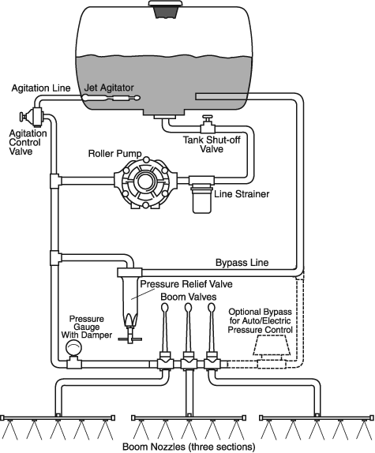

Timing of Applications
Preplant
Preemergence
Postemergence
To the turfgrass & weed
After the turfgrass is planted but before crop or weeds emerge
OR
To the turfgrass
After the turfgrass is established and/or weeds emerge
To control emerged weeds before the turfgrass is established
Before the turfgrass is planted
OR
Two primary placement options for herbicides:
= Weed Seed
To the weed
After turfgrass is established but before weeds emerge
= Turfgrass
Seed or sprigs
Soil Application
Foliar Application
Notes:
Other terms commonly used with herbicides are related to application timing. <mouse click> Preplant herbicides are applied before the turfgrass species is planted. <mouse click> Preemergence herbicides can be applied 1) before the turfgrass and weeds emerge; 2) after the weeds emerge, but before the turfgrass emerges, commonly called a burndown treatment; or 3) after the turfgrass emerges but before the weeds emerge. <mouse click> Postemergence herbicides are applied after the turfgrass and weeds emerge. <mouse click>
Herbicide applications can be directed at two primary placements: the soil or the foliage.
<mouse click>

Slide 10
Placement of Applications: Soil
Soil application
In contact with germinating or emerging weeds
In contact with roots of emerged weeds
Moisture must be present for herbicide movement into the plant.
Notes:
Herbicides that are soil applied can affect <mouse click> germinating or emerging weeds or <mouse click> the roots of young weeds. The choice of which soil-residual herbicide to use is usually based on the weed species expected and their levels of infestation. <mouse click> Adequate soil moisture is critical for activity of soil-applied herbicides because it is necessary for herbicide movement into the soil solution where it is available for uptake into the plant.
<mouse click>

Slide 11
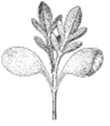

Placement of Applications: Foliar
Foliar application
Applied directly to the leaves of plants
Notes:
Foliar-active herbicides are a dominant component in some weed management programs. The main advantage of using foliar applied herbicides is that the herbicide comes <mouse click> in direct contact with identified weed species at observed infestation levels. Disadvantages are that timeliness of the herbicide application is important to effectively protect crop yield potential, and herbicide efficacy is generally dependent on the size of the weeds at the time of application. Stress, such as from low moisture or other factors, can also limit the effectiveness of foliar active herbicides.
<mouse click>

Slide 12

Herbicide Translocation in Plants
The movement, or lack thereof, of herbicides through plants after application determines how the herbicide is to be applied to obtain acceptable weed control. Herbicide translocation in plants is necessary to move the active ingredient to the location where it can inhibit plant systems. Movement of herbicides in plants can occur via:
  No translocation
  Translocation from root to shoot
  Translocation throughout the plant (systemic)
    Shown on the right
Notes:
Herbicide translocation in plants is necessary to move the active ingredient to the location where it can inhibit plant systems. <mouse click> Herbicide products that are applied to the soil and do not move in plants must be applied preplant or preemergence, and before weed seeds begin to germinate and emerge; examples include the dinitroaniline or chloroacetamide herbicides. Foliar applied herbicides that do not translocate are termed contact herbicides. They affect processes in the leaves that are contacted by the active ingredient; examples of contact herbicides are the PPO inhibitors, glufosinate, and paraquat.
<mouse click> Herbicides that translocate primarily from roots to shoots are soil applied herbicides that are taken up by the roots of emerging or emerged plants and move to the leaves where they inhibit plant processes; examples include the triazine herbicides.
<mouse click> Herbicides that translocate throughout the plant are often called systemic herbicides because they can move throughout the plant whether from the soil or the foliage as in the case of sulfonylurea herbicides, or from foliage only as in the case of glyphosate.
<mouse click>

Slide 13
Mode of Action and Mechanism of Action
Herbicide Mode of Action: The plant processes affected by the herbicide, or the entire sequence of events that results in death of susceptible plants.
  Includes absorption, translocation, metabolism & interaction at the mechanism of action
Herbicide Mechanism of Action: The biochemical site within a plant with which a herbicide directly interacts. Site of action is sometimes used instead of mechanism of action.
The term
mode of action is often incorrectly used to refer to mechanism of action.
For More
Information
Notes:
Two terms that you may frequently encounter in technical discussions about herbicide use are mode of action and mechanism of action. <mouse click> Herbicide mode of action refers to all of the plant processes affected by the herbicide, or the entire sequence of events that ultimately results in death of susceptible plants. It includes herbicide absorption, translocation, metabolism, and interaction at the mechanism of action. In contrast, <mouse click> mechanism of action is a very specific event within mode of action. It refers to the biochemical site within a plant with which a herbicide interacts. There are generally 8 or 9 described modes of action, but there are currently over 20 different mechanisms of action. <mouse click> The term mode of action is often incorrectly used to refer to mechanism of action.
For examples of how weed scientist classify herbicides as to mode and mechanism of action, please click on the For-More-Information button.
<mouse click>

Slide 14
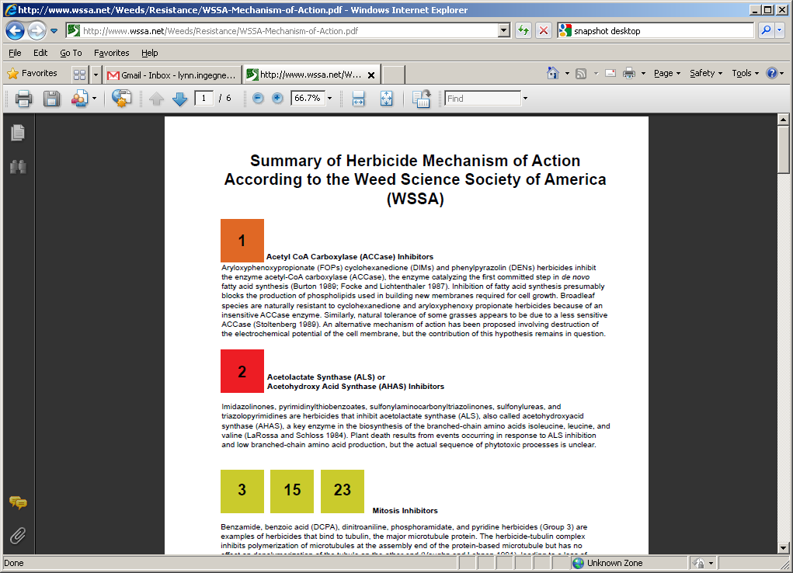
Categorization by Mechanism of Action
The numbering system assigns each herbicide to a mechanism of action group. Link to herbicide mechanism of action classification
The EPA recommends that labels display the group number that identifies the mechanism of action for the active ingredient(s) in a formulated product.
Notes:
In 1997, the Herbicide Resistance Action Committee and WSSA approved a herbicide categorization system based on herbicide mechanism of action. The classification system was developed with the idea that if herbicide mechanism of action was well known, recommendations for herbicide resistance management would be easier to understand.
Herbicides with the same mechanism of action were assigned <mouse click> a group number. These numbers may be listed on herbicide product labels. The EPA recommends currently that herbicide labels display the group number that identifies the mechanism of action for all active ingredients in the herbicide product.
When planning a herbicide program to prevent or mitigate the evolution of herbicide resistance in weeds, rotation among herbicides with different group numbers is necessary. More information on managing herbicide resistance is presented in Lesson 5.
<mouse click>

Slide 15
Goal of the Mechanism of Action Numbering System
The goal of herbicide group number classification system is to provide a tool that aids in herbicide selection.
Herbicide labels also include herbicide resistance management guidelines to direct growers and dealers to local extension experts for assistance with weed management decisions.
?
Herbicide A
?
or
?
Herbicide B
Notes:
The goal of the herbicide group number classification system is to provide a tool that aids in herbicide selection. Because mechanism of action is by far the most specific and complex method for categorizing herbicides, the group number simplifies the relationships and identification process.
<mouse click> Herbicide labels also include herbicide resistance management guidelines to direct growers and dealers or retailers to local extension experts for assistance with weed management decisions.
<mouse click>

Slide 16
Examples of Mechanism of Action on Labels
The product with this symbol on the label contains glyphosate, an active ingredient in Group 9; the mechanism of action is binding to the EPSP synthase enzyme resulting in inhibition of aromatic amino acid formation.
9
GROUP HERBICIDE
The product with this symbol on the label contains atrazine, an active ingredient in Group 5; the mechanism of action is binding to the Q₈-binding niche on the D1 protein of the photosystem II complex in the chloroplast thylakoid membranes resulting in inhibition of photosynthesis.
5
GROUP HERBICIDE
The product with this symbol contains s-metolachlor, glyphosate, and mesotrione, active ingredients with three different mechanisms of action, designated by Group 15 - inhibition of very long chain fatty acids resulting in inhibition of cell division; Group 9 - binding to the EPSP synthase enzyme and Group 27 – inhibition of 4-HPPD resulting in bleaching of the plants, respectively.
15 9 27
GROUP HERBICIDE
Notes:
These are examples of mechanism of action group numbers and descriptions that appear on some herbicide labels.

Slide 17
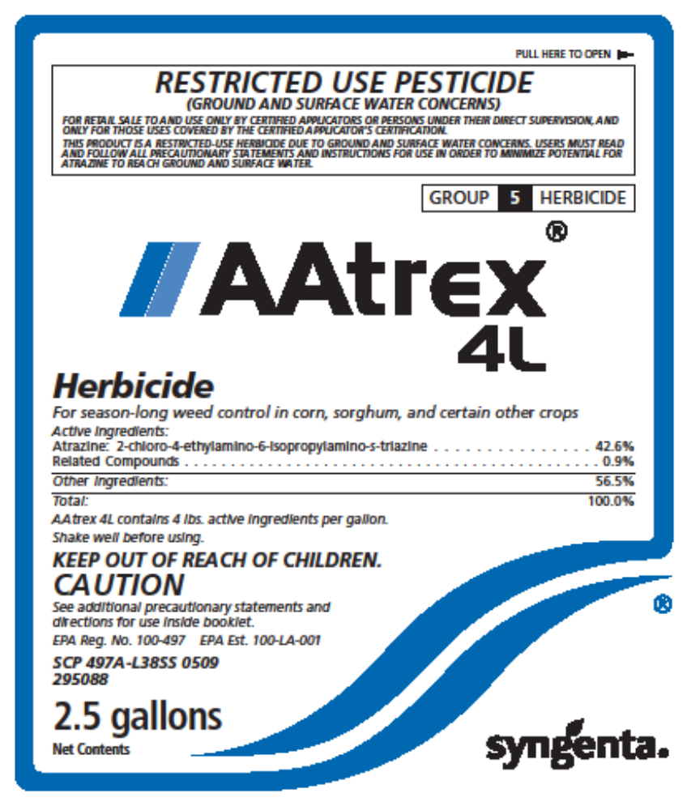
Example of a Group Number on a Label
Mechanism of Action Group Number
Notes:
This is an example of a herbicide label showing where the group number may be found. This location may vary from product to product.

Slide 18
Conclusions
Herbicides are important weed management tools that are described by tolerance, chemistry, efficacy, timing, and placement of applications.
Herbicides are categorized by Mode of Action and Mechanism of Action.
Categorization according to mechanism of action is important from a herbicide resistance management standpoint.
Notes:
This concludes the lesson on how herbicides work. This lesson provided information on several important terms related to herbicides and herbicide use, including: tolerance, chemistry, efficacy, timing, and placement of applications.
By now, you also know <mouse click> several forms of herbicide categorization, including <mouse click> the form that is most related to the management of herbicide-resistant weeds: mechanism of action.
Three additional training lessons follow. You may continue with these lessons now, or save your work and return at a later time.
<mouse click>

Slide 19
Credits:
This lesson was developed by a WSSA sub-committee and reviewed by the WSSA Board of Directors and other WSSA members before being released. The sub-committee was composed of the following individuals.
Shawn Askew, PhD (Virginia Tech University)
Jim Brosnan, PhD (University of Tennessee)
Wes Everman, PhD (North Carolina State University)
Les Glasgow, PhD (Syngenta Crop Protection)
Lynn Ingegneri, PhD (Consultant)
Ramon Leon, PhD (University of Florida)
Scott McElroy, PhD (Auburn University)
Jill Schroeder, PhD (New Mexico State University)
David Shaw, PhD (Mississippi State University)
John Soteres, PhD (Monsanto Company) (Sub-committee chairman)
Jeff Stachler, PhD (North Dakota State University and University of Minnesota)
François Tardif, PhD (University of Guelph)
Financial support for this was provided by Global HRAC, North America HRAC, and WSSA.
Our thanks are extended to the National Corn Growers Association for allowing us to use training materials posted on their website as the starting point for these training lessons.

Slide 20
Classification Hierarchy
Example
Photosynthesis Inhibitor
Group 5
Group 7
Herbicide Name
Herbicide Family
Mechanism of Action
Mode of Action
Triazine
Triazinone
Atrazine “AAtrex” etc.
Metribuzin “Sencor” etc.
Substituted Urea
Diuron “Direx” etc.
Two MOAs
Notes:
<Narrative below covers both slides on classification hierarchy.>
As stated previously, mode of action describes the overall effect of herbicides on plants, including the symptoms observed after treatment. Mode of action can be considered “the big picture.” However, herbicides within a common mode of action may interact at different biochemical sites in the plant, a process differentiated by herbicide mechanism of action. Mechanism of action can be considered “a specific detail.”
Herbicides from different families may have different mechanisms of action as shown on this slide, where triazines and substituted ureas (two different families) have different mechanisms of action, or herbicides from different families, such as the “dims,” “fops,” and “dens” (as shown on the next slide) may act on the same mechanism of action.
It may help to remember that mode of action and mechanism of action are terms referring to the general and specific responses of the susceptible plant, while categorization according to herbicide family is based on the chemical characteristics of the herbicide molecules.
< The launch of Slide 17 will need to run on autoplay because the narrative covers both examples.>

Slide 21
Classification Hierarchy
Click here
To return
Example
Lipid Synthesis Inhibitors
Group 1
ACCase Inhibitors
Herbicide Name
“Dims”
“Fops"
Sethoxydim “Segment” etc.
Fluazifop-P-butyl “Fusilade” etc.
“Dens”
Herbicide Family
Mode of Action
Mechanism of Action
Pinoxaden “Axial” etc.
One MOA

